Slide 1

Global
Gold Investment
Report
2025

Slide 2

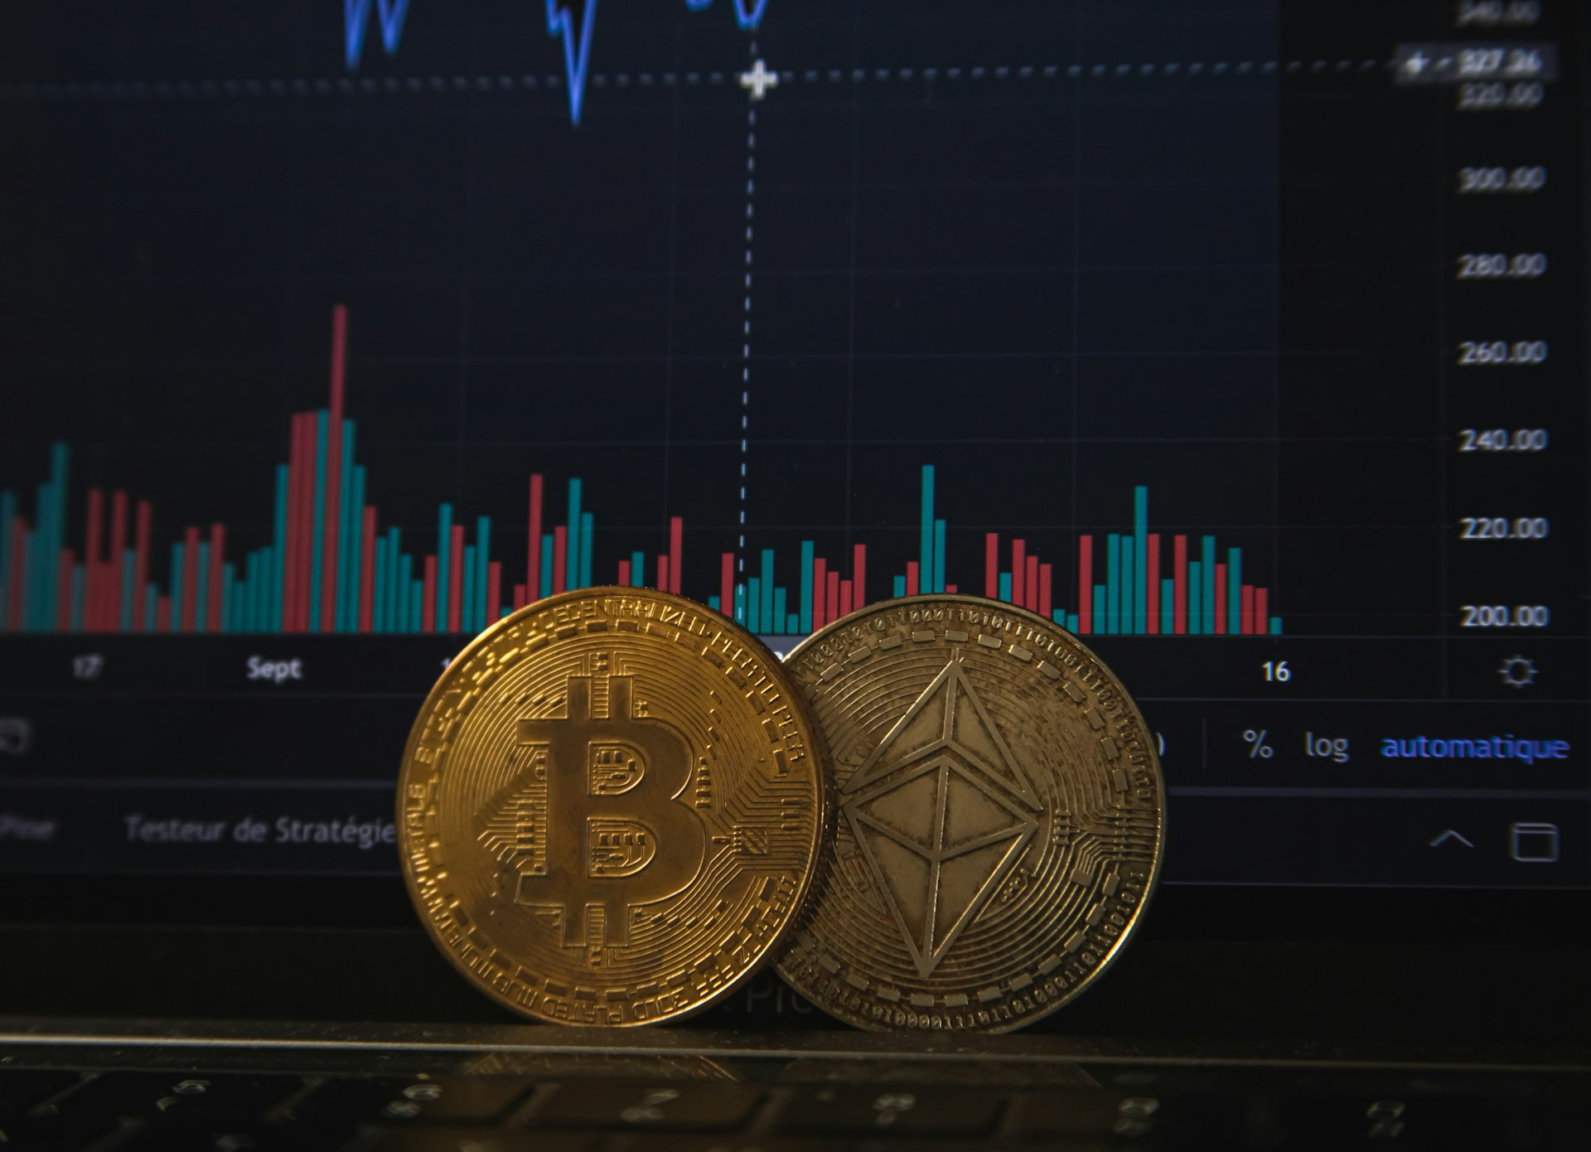


Table of Contents
Methodology
3
Executive Summary
6
Market Analysis
12
Investment Outlook
54
2

Slide 3

Methodology

Slide 4


Defining Gold Investment
Each investor's approach to gold varies. For some, it represents the ultimate store of value and hedge against uncertainty. For others, it centers around specific factors, like portfolio diversification or protection against currency debasement. For the purposes of this analysis, "gold investment" is defined by three core elements. The balance of these three elements makes up the core of building wealth and preserving capital.
Physical Security
Holding tangible assets that maintain value independent of counterparty risk and government policy.
Financial Protection
Safeguarding wealth against inflation, currency weakness, and market volatility.
Portfolio Diversification
Allocating to an asset with low correlation to traditional stocks and bonds.
4

Slide 5
This report synthesizes data from multiple authoritative sources including central bank reserve data, World Gold Council demand trends, and forecasts from major financial institutions including J.P. Morgan, Goldman Sachs, UBS, and Morgan Stanley.
Methodology
GLOBAL MARKETS ANALYZED: ● United States ● United Kingdom ● Canada ● Germany ● France ● Switzerland ● Spain ● China ● Japan ● Hong Kong S.A.R. ● Singapore ● Australia ● India ● UAE ● South Africa
5,000+ tonnes in total
Analysis period: January 2025 – December 2026 n=14 markets analyzed globally Coverage includes: North America, Europe, Asia-Pacific, Middle East Markets analyzed: United States, United Kingdom, Germany, France, Switzerland, China, India, Japan, Australia, UAE, Singapore, Hong Kong S.A.R., Canada, South Africa
5

Slide 6

Executive Summary

Slide 7
The Gold Investment Imperative
Overall,
64%
Investors are increasingly recognizing gold as essential for portfolio protection—yet many remain underexposed. This paradox reflects a historic opportunity that investors around the world are seizing with conviction. They see gold not as a speculative trade, but as a fundamental pillar of wealth preservation in an era of unprecedented monetary policy and geopolitical uncertainty. Central banks, institutions, and retail investors have demonstrated this through record-breaking purchases, driving gold to over 50 all-time highs in 2025.
price appreciation in 2025 alone.
Plus
27%
additional gains year-to-date in early 2026.
Our objective with this report is to provide a comprehensive view of gold's role in the global investment landscape, as we continue to see greater recognition of its importance for portfolio resilience and long-term wealth preservation.
And Only
3%
7
current allocation in household portfolios.

Slide 8
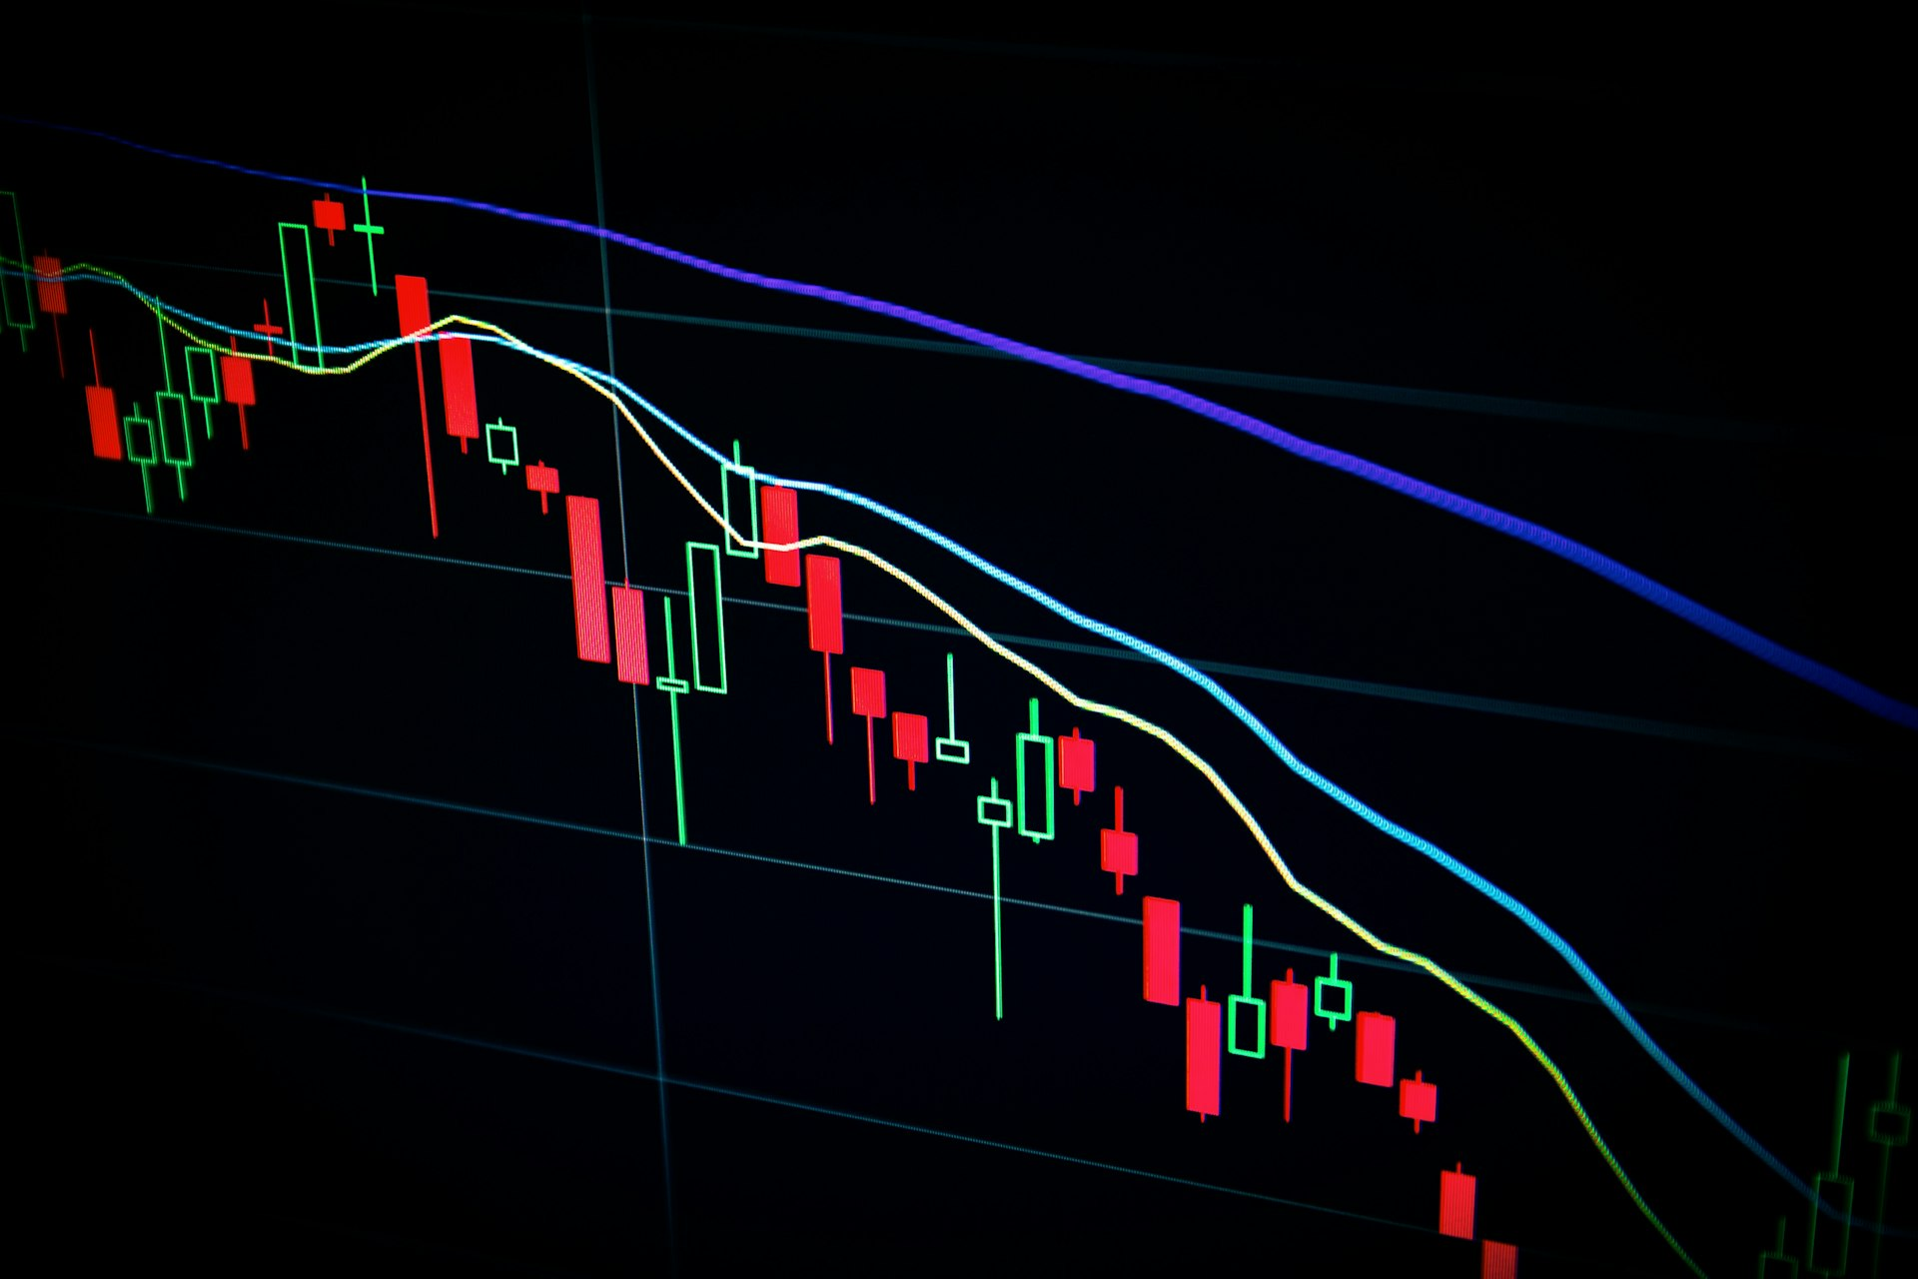
Why this is happening.
Monetary Policy Uncertainty
Currency Debasement Risk
Geopolitical Instability
$340 trillion
30%
$555 billion
in global debt (3-4x global GDP)
weaker U.S. dollar vs. historical norms
in total gold demand value in 2025
Fed rate cuts
863 tonnes
Trade tensions
initiated late 2025, continuing into 2026
of central bank gold purchases in 2025
driving safe-haven demand
Real yields falling
95%
Banking sector concerns
as inflation concerns persist
of central banks expect to increase reserves
prompting flight to quality
Quantitative easing
800 tonnes
50+
returning after tightening pause
projected central bank buying in 2026
all-time price highs reached in 2025
8

Slide 9

How demand is manifesting.
Investment Inflows Accelerating
Central Banks Leading the Way
Supply Remains Constrained
801 tonnes
Poland
3,672 tonnes
ETF inflows in 2025 (second-highest on record)
added 102 tonnes, reaching 28% of reserves
mine production in 2025
1,303 tonnes
230 tonnes
<2% annual
Q4 2025 demand (highest quarter ever)
Q4 2025 accelerated central bank buying
addition to global stock from new mining
250 tonnes
26%
1,404 tonnes
additional ETF inflows expected in 2026
of annual mine output absorbed by central banks
recycled gold (up only 3%)
12-year high
Reserve diversification
Limited distress selling
in bar and coin demand
away from U.S. dollar continues
even at record prices
9

Slide 10
Investment targets: Multiple scenarios point higher.
Conservative Forecasts
Moderate Bull Case
Aggressive Upside
$5,000/oz
$5,700/oz
$8,000-$8,500/oz
J.P. Morgan base case by Q4 2026
Morgan Stanley H2 2026 bull scenario
J.P. Morgan upside scenario
$5,400/oz
$6,200/oz
$7,200/oz
Goldman Sachs target December 2026
UBS mid-2026 target (27% upside)
UBS high geopolitical risk case
5-15% gains
$5,900/oz
$10,000/oz
World Gold Council 2026 expectation
UBS year-end 2026 moderation
AI-driven outlier prediction
$4,135/oz
4.6%
$2.5 trillion
Q4 2025 average price (55% YoY)
household allocation scenario
potential demand from 1% reallocation
All forecasts depend on macroeconomic conditions, geopolitical developments, and investor allocation decisions. The path forward likely includes periods of heightened volatility, but the structural factors supporting gold remain firmly in place.
10

